Slide 1

FOOD RUNNER APP
Submitted To:-
JIVESH (Supervisior)
SUBMITED BY
DIWAKAR MISHRA

Slide 2
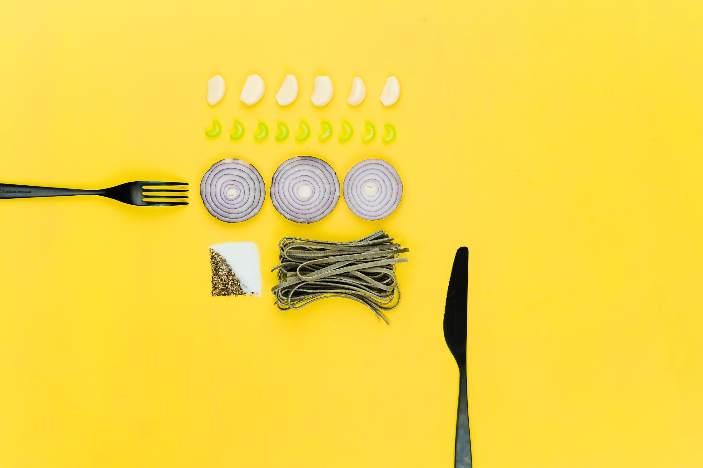
ABSTRACT
The simplicity and ease of access of a menu are the main things that facilitate ordering food in a restaurant.
A Table menu completely revolutionizes the patron’s dining experience. Existing programs provide an app
that restaurants can use to feed their menus into Android based tablets and make it easier for the diners to
flip , swipe & tap through the menu. We here aim to provide the restaurants with a tablet menu that would
recommend dishes based on recommendation algorithm which has not been implemented elsewhere In
addition to this we run the app on a Android based tablet & noton an iOS based tablet which is more
expensive alternative. We use a cloud-based Server for storing the database which makes it inexpensive &
secure.The prime objective of “best Restaurant finder "is to create a full fledged Android application which
could locate a list of restaurants based on the location & type of the cuisine entered by the user. The user
not only finds all the restaurants in the city, but also he can make a choice of the best restaurant based on
the rating & cuisine he chooses to have. They can also obtain the detailed review of the restaurant he
chooses. The Project is developed in kotlin Language by using IntelliJ IDEA.
Integrated Development Environment (IDE).We use the Android Software Developmen Kit (SDK) which
includes a variety of custom tools that help us develop mobile applications on the Android platform. The
most important of these are the Android Emulator and the Android Development Tools (ADT) plug-in for
IntelliJ IDEA

Slide 3

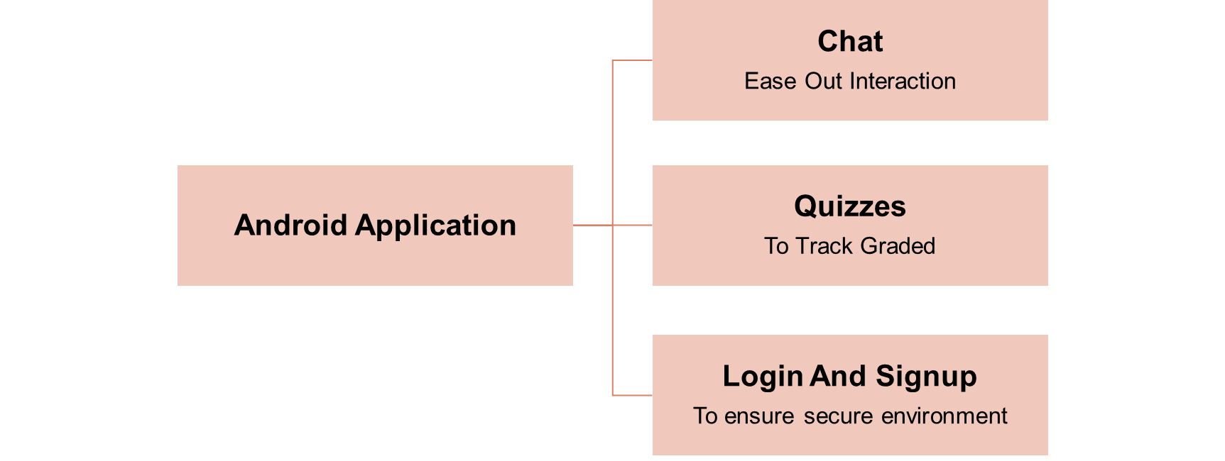

Slide 4

Technology Used
KOTLIN
UI DESIGN
XML
SQlite

Slide 5
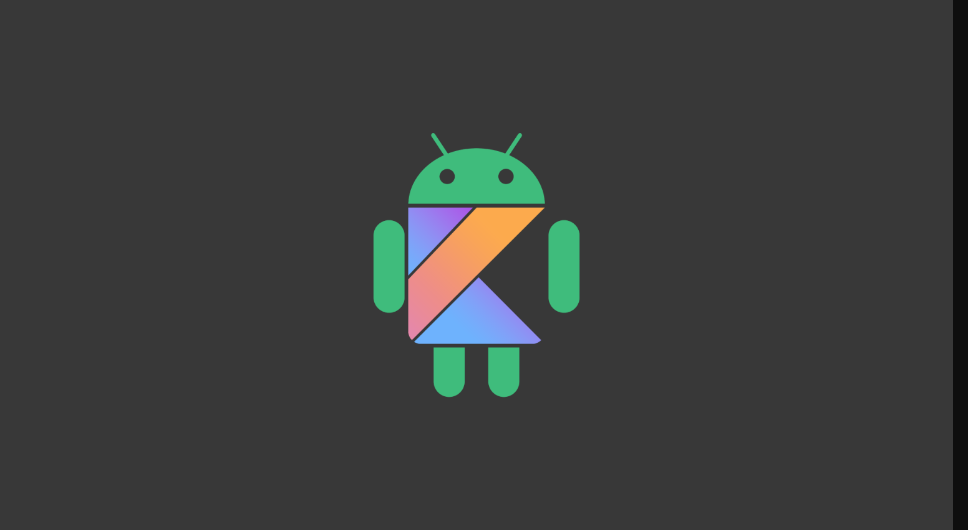
KOTLIN
Using Kotlin for Android Development
Using Kotlin for Android development, you can benefit from:
Less code combined with greater readability. Spend less time writing your code and working to understand the code of others.
Mature language and environment. Since its creation in 2011, Kotlin has developed continuously, not only as a language but as a whole ecosystem with robust tooling. Now it's seamlessly integrated in Android Studio and is actively used by many companies for developing Android applications.
. Kotlin support in Android Jetpack and other libraries. KTX extensions add Kotlin language features, such as coroutines, extension functions, lambdas, and named parameters, to existing Android libraries.
Interoperability with Java. You can use Kotlin along with the Java programming language in your applications without needing to migrate all your code to Kotlin.
Support for multiplatform development. You can use Kotlin for developing not only Android but also iOS, backend, and web applications. Enjoy the benefits of sharing the common code among the platforms.
Code safety. Less code and better readability lead to fewer errors. The Kotlin compiler detects these remaining errors, making the code safe.
Easy learning. Kotlin is very easy to leam, especially for Java developers.
Big community. Kotlin has great support and many contributions from the community, which is growing all over the world. According to Google, over 60% of the top 1000
Kotlin is an open-source, statically-typed programming language that supports both object- oriented and functional programming. Kotlin provides similar syntax and concepts from other languages, including C#, Java, and Scala, among many others. Kotlin does not aim to be unique instead, it draws inspiration from decades of language development. It exists in variants that target the JVM (Kotlin/JVM), JavaScript (Kotlin/JS), and native code (Kotlin/Native). Kotlin's interoperability with Java means that you don't have to adopt Kotlin all at once. You can have projects with both Kotlin and Java code. For more information on adding Kotlin to an existing app, see Add Kotlin to an existing app. If you are a part of a larger team, the size of your organization and codebase may necessitate special focus. For tips and other information, see Adopt Kotlin for large teams.

Slide 6

Designing User Interfaces for Users
User interfaces are the access points where users interact with designs. They come in three formats:
Graphical user interfaces (GUIs)—Users interact with visual representations on digital control panels. A computer’s desktop is a GUI.
Voice-controlled interfaces (VUIs)—Users interact with these through their voices. Most smart assistants—e.g., Siri on iPhone and Alexa on Amazon devices—are VUI
Gesture-based interfaces—Users engage with 3D design spaces through bodily motions: e.g., in virtual reality (VR) games.
To design UIs best, you should consider:
Users judge designs quickly and care about usability and likeability.
They don’t care about your design, but about getting their tasks done easily and with minimum effort.
Your design should therefore be “invisible”: Users shouldn’t focus on it but on completing tasks: e.g., ordering pizza on Domino’s Zero Click app.
So, understand your users’ contexts and task flows (which you can find from, e.g., customer journey maps), to fine-tune the best, most intuitive UIs that deliver seamless experiences.
UI DESIGN
User interface (UI) design is the process designers use to build interfaces in software or computerized devices, focusing on looks or style. Designers aim to create interfaces which users find easy to use and pleasurable. UI design refers to graphical user interfaces and other forms.

Slide 7

Table Of Contents:
Basics Of User Interface:
Different XML Files Used in Android:
Basic of user Interface:
The whole concept of Android User Interface is defined using the hierarchy of View and ViewGroup objects. A ViewGroup is an invisible container that organizes child views. These child views are other widgets which are used to make the different parts of UI. One ViewGroup can have another ViewGroup as an child element as shown in the figure given. below:
XML
XML stands for Extensible Markup Language. XML is a markup language much like HTML used to describe data. XML tags are not predefined in XML. We must define our own Tags. Xml as itself is well readable both by human and machine. Also, it is scalable and simple to develop. In Android we use xml for designing our layouts because xml is lightweight language so it doesn't make our layout heavy. In this article we will go through the basic concepts of xml in Android and different XML files used for different purpose in Android. This will help you in writing a UI code to design your desired user interface.

Slide 8
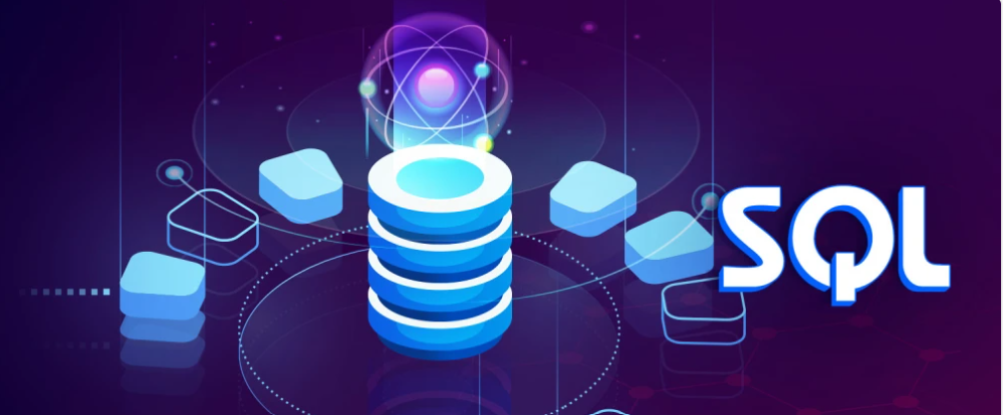
SQLite SQLite is an in-process library that implements a self-contained, serverless, zero-configuration, transactional SQL database engine. It is a database, which is zero-configured, which means like other databases you do not need to configure it in your system. SQLite engine is not a standalone process like other databases, you can link it statically or dynamically as per your requirement with your application. SQLite accesses its storage files directly
Why SQLite?
SQLite does not require a separate server process or system to operate (serverless).
SQLite comes with zero-configuration, which means no setup or administration needed.
A complete SQLite database is stored in a single cross-platform disk file.
SQLite is very small and light weight, less than 400KiB fully configured or less than 250KiB with optional features omitted.
SQLite is self-contained, which means no external dependencies.
SQLite transactions are fully ACID-compliant, allowing safe access from multiple processes or threads.
SQLite supports most of the query language features found in SQL92 (SQL2) standard.
SQLite is written in ANSI-C and provides simple and easy-to-use API.
SQLite is available on UNIX (Linux, Mac OS-X, Android, iOS) and Windows (Win32, WinCE, WinRT).

Slide 9

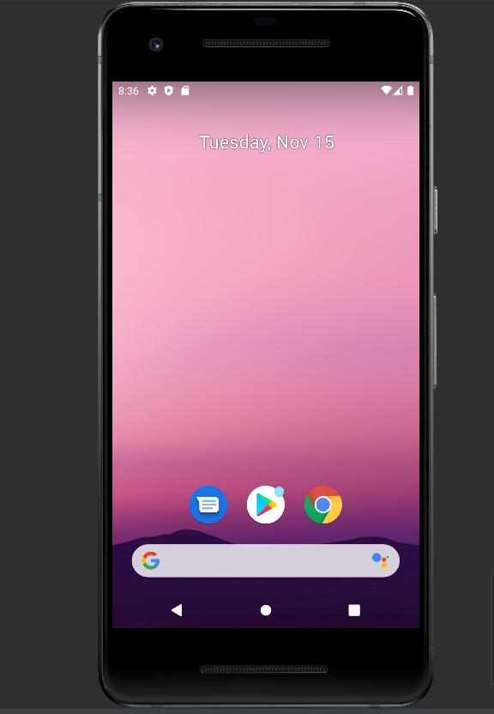
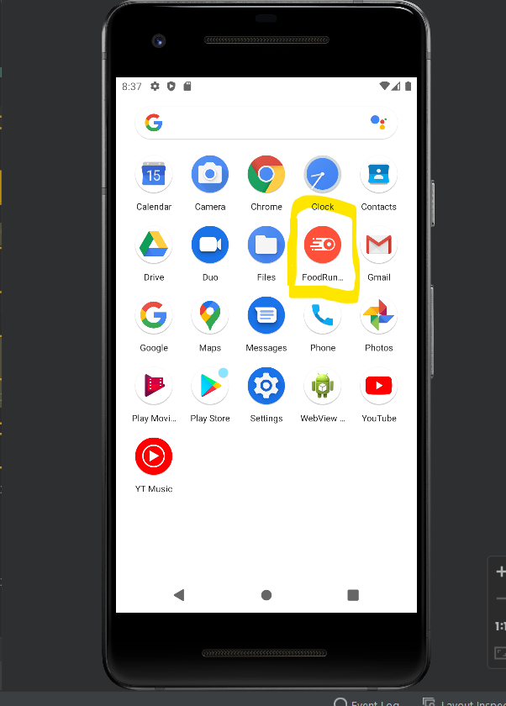
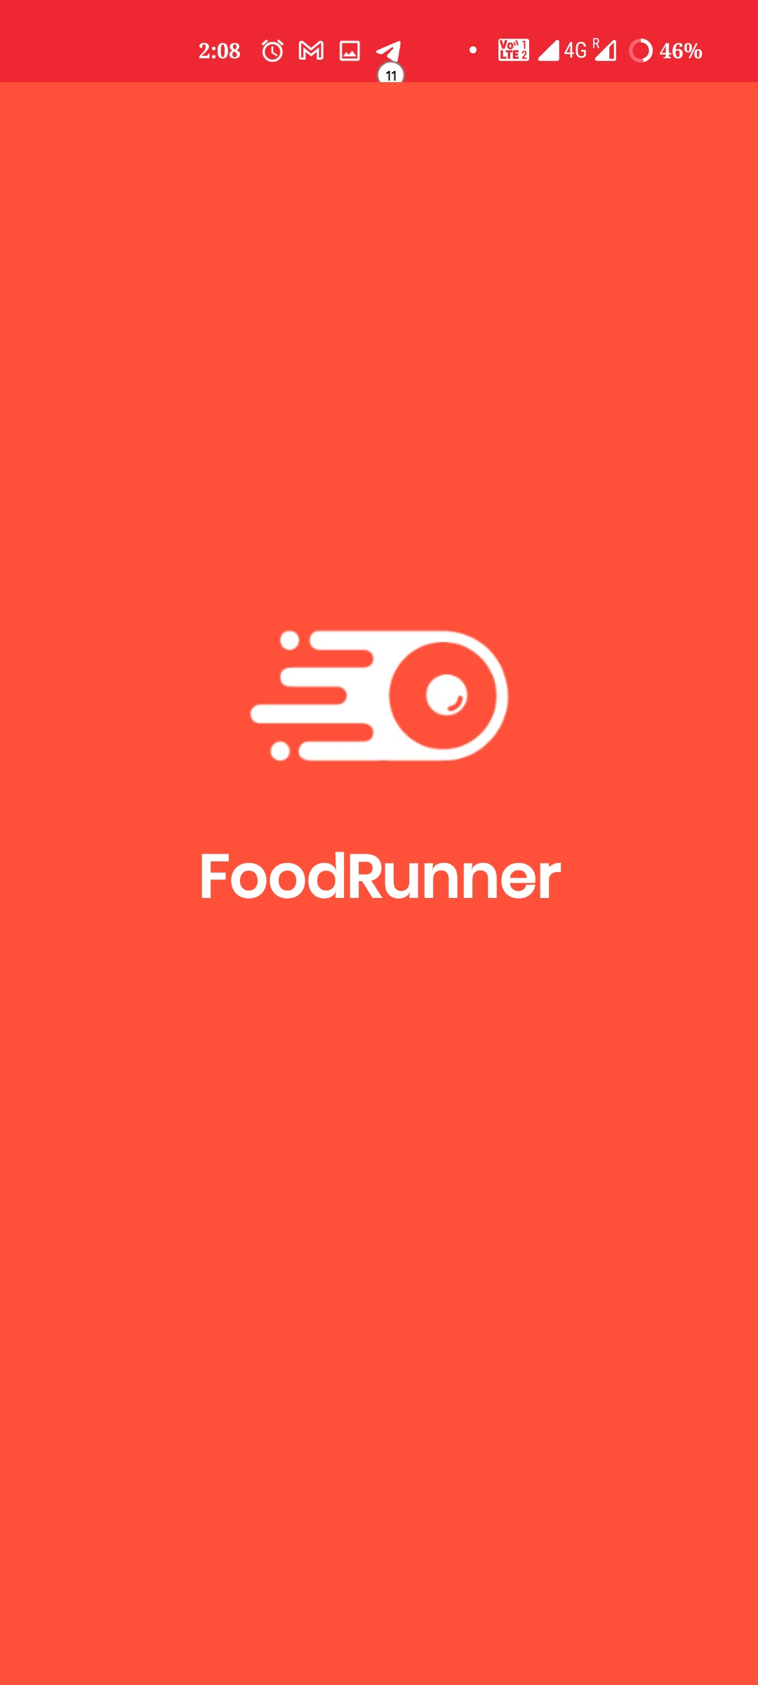
Home Screen

Slide 10

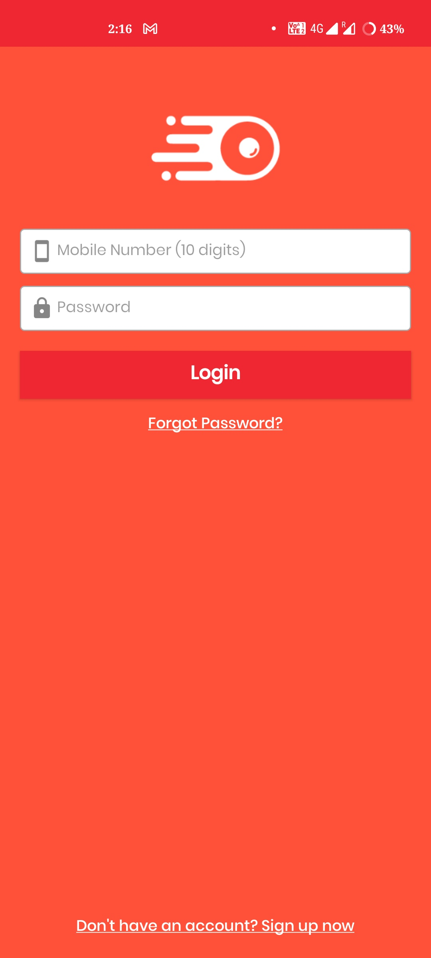
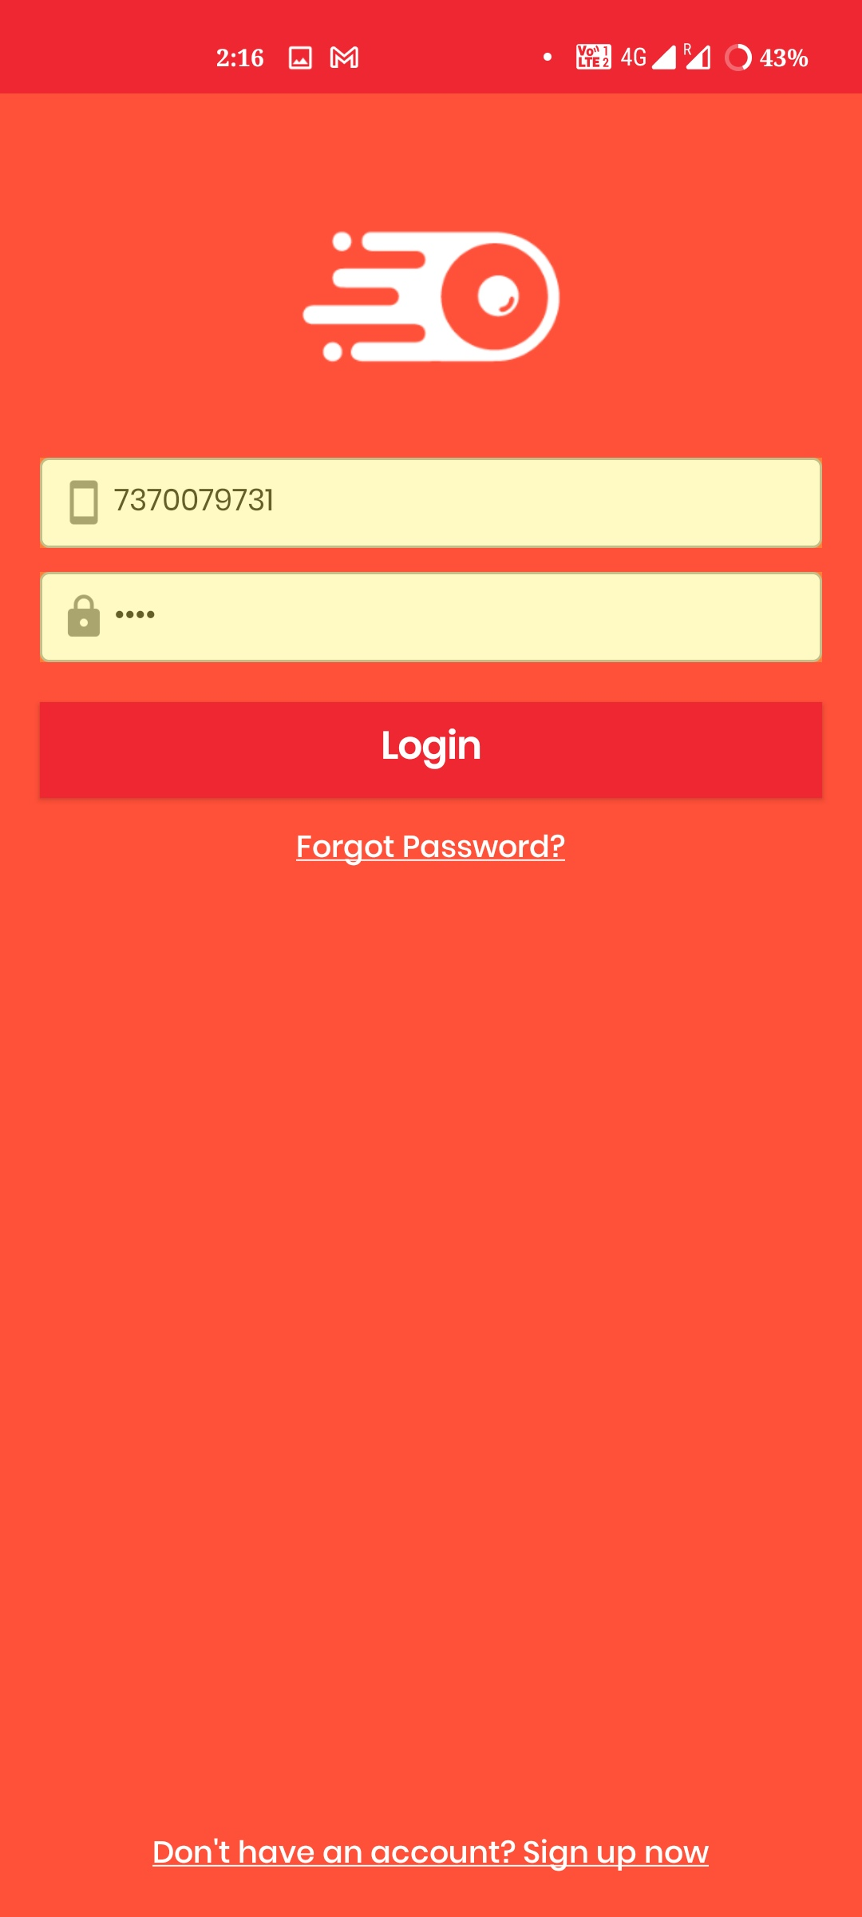
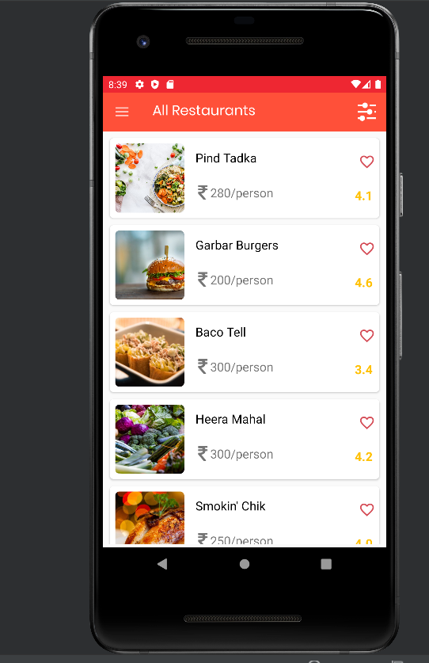
SIGN UP OPTION
LOGIN PAGE
HOME PAGE

Slide 11
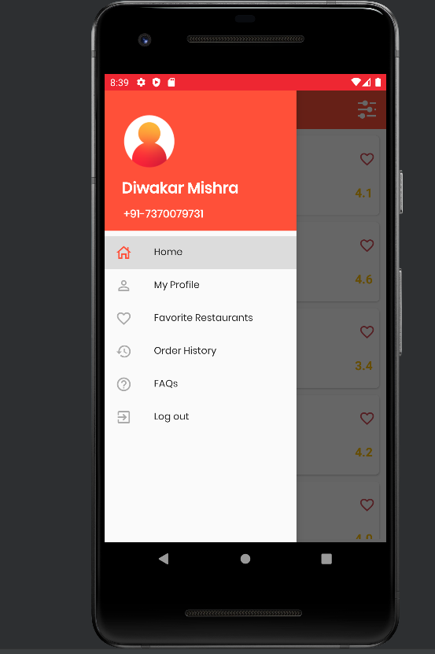
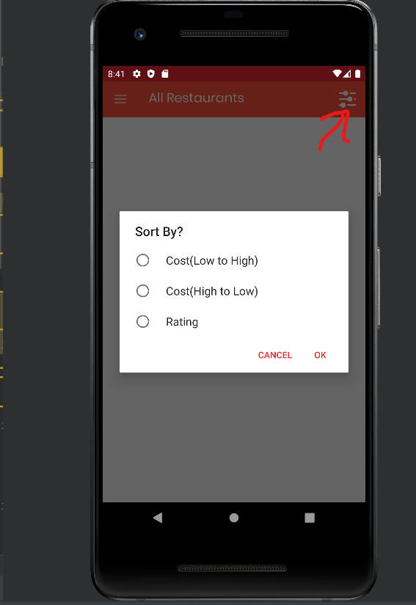

Slide 12
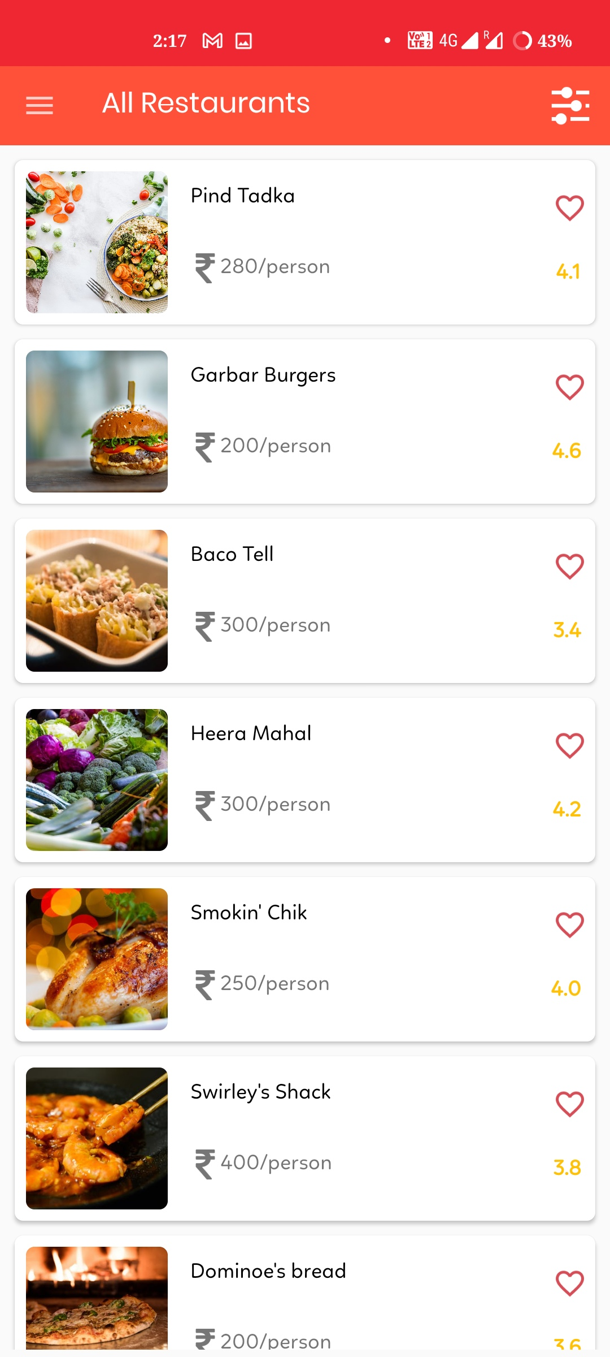
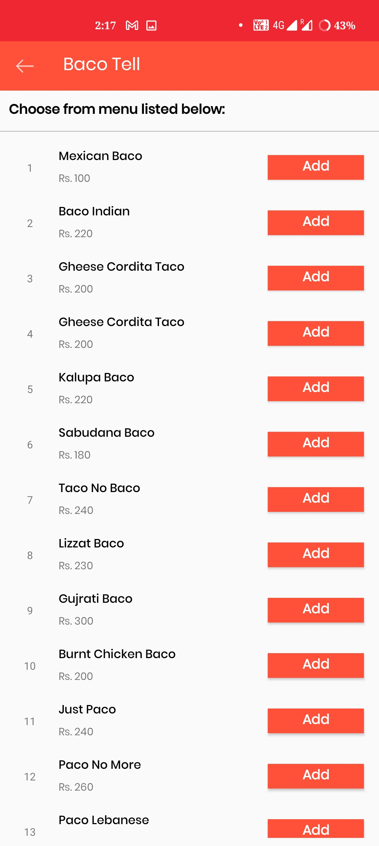
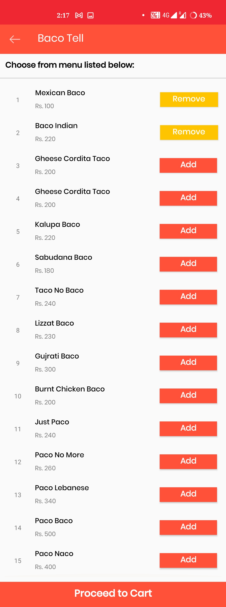

Slide 13
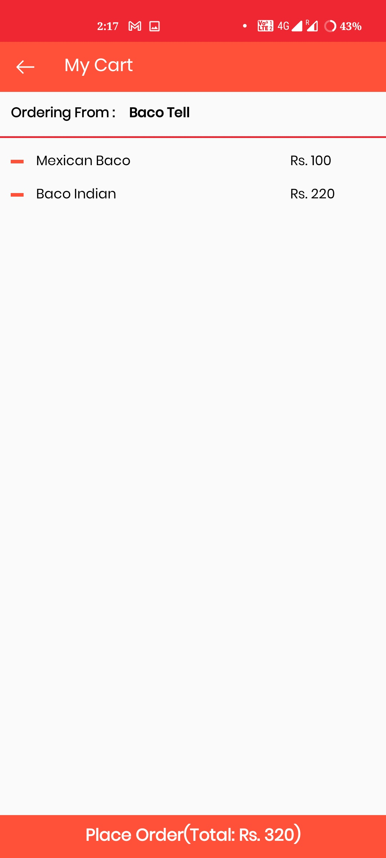
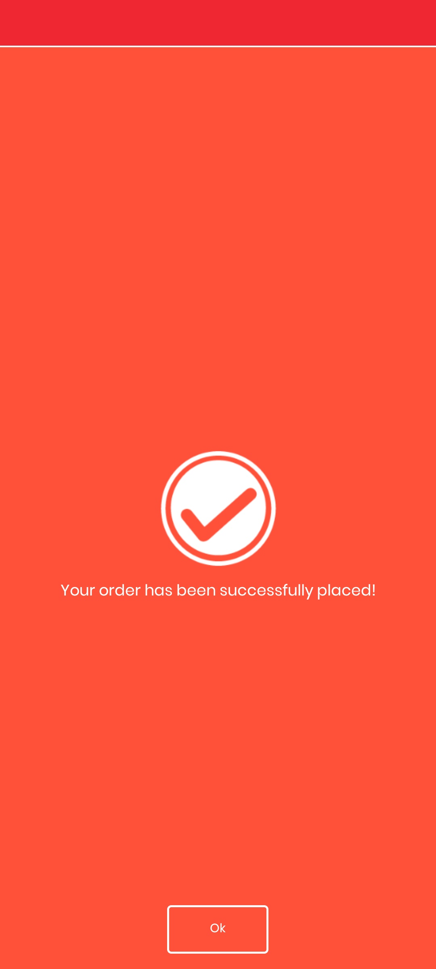

Slide 14


